Slide 1
Training

Slide 2
Where do I go?

Slide 3
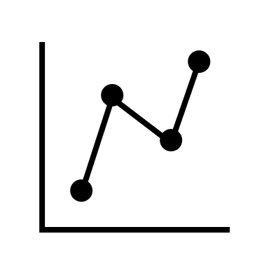
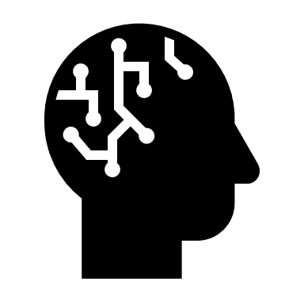



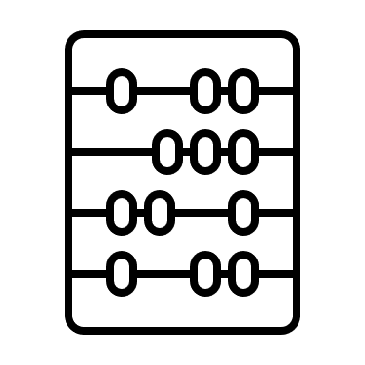

What is Machine Learning?
We take data from the past.
A machine Learning Algorithm will process the data.
It can make predictions and find trends.
Simply, Machine Learning uses computers and data to solve problems.
Notes:
Maybe too much on the slide, split up.
What is a machine learning algorithm? Maybe mention that on the slide before. What are the problems we are trying to solve?

Slide 4
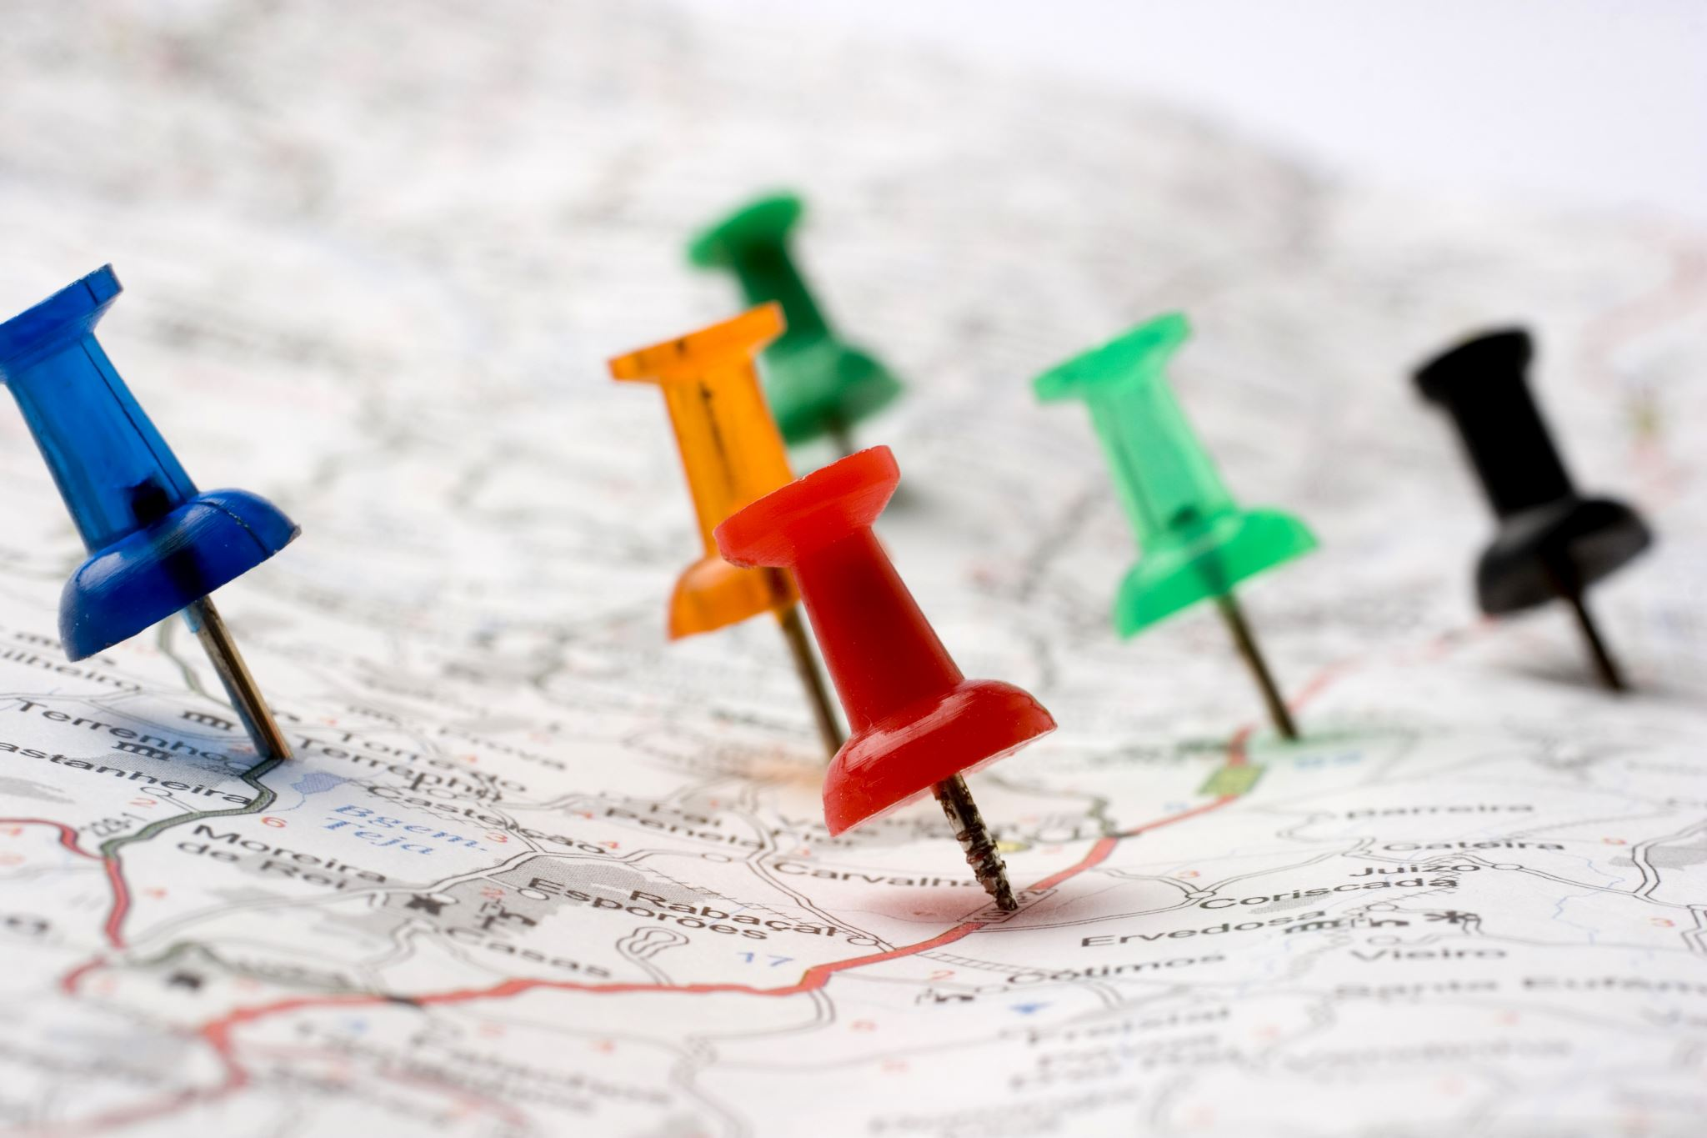
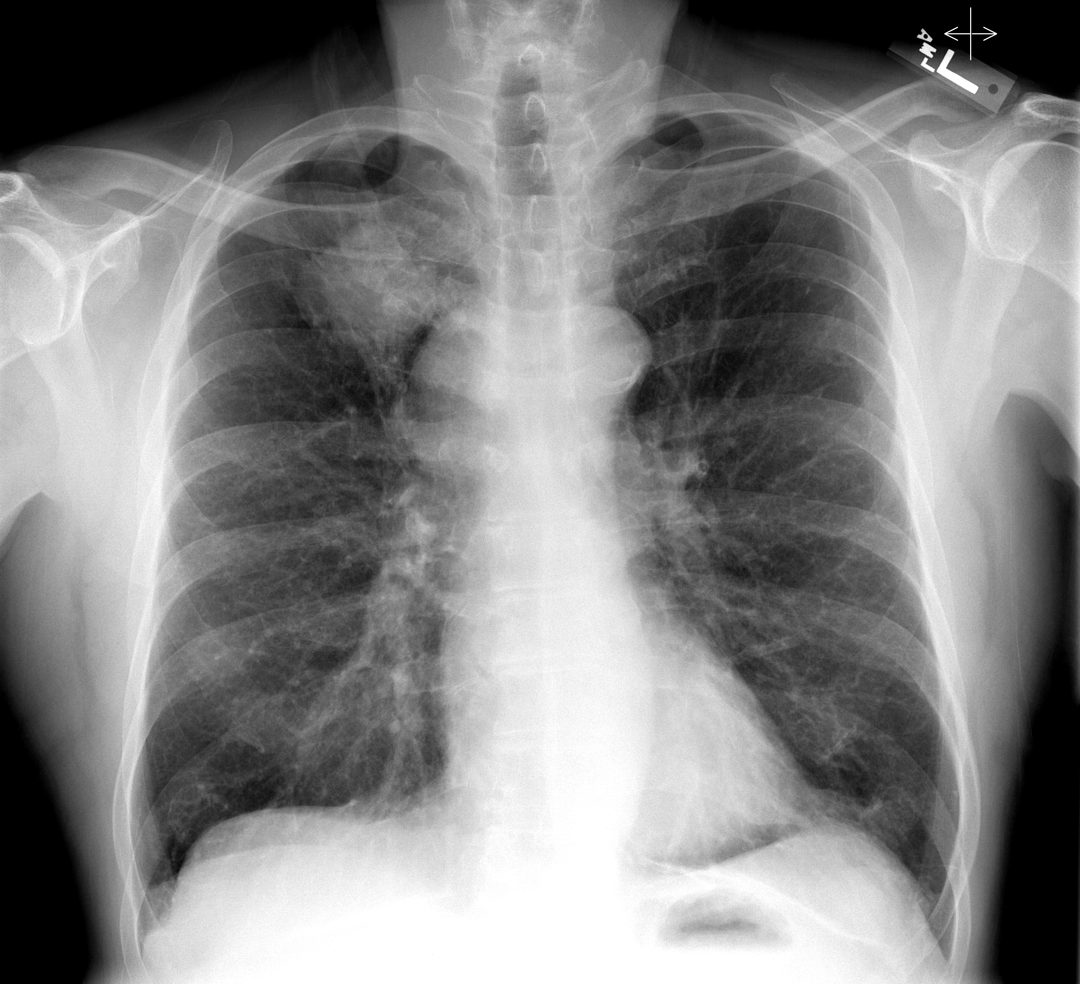
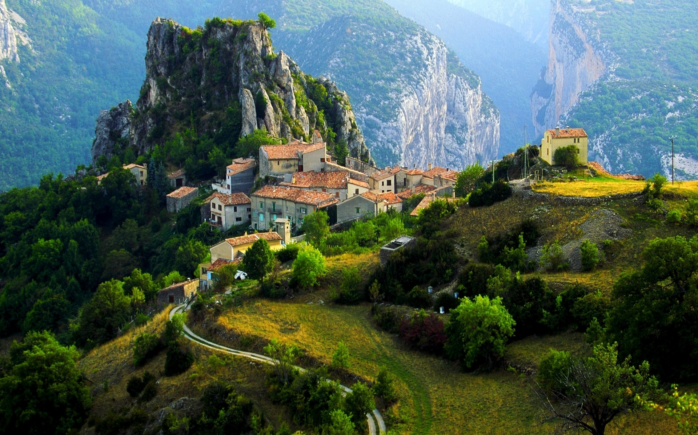
What Problems can Machine Learning Solve?
Can I group together similar local authorities based on statistics from each authority?
Based on past data, can I tell if someone has lung cancer from an X-ray of their chest?
Based on past data, how much rainfall will a new housing estate receive if I build it at an altitude of 1300m?
Notes:
Maybe too much on the slide, split up.
What is a machine learning algorithm? Maybe mention that on the slide before. What are the problems we are trying to solve?

Slide 5
Different Problems need Different Algorithms
This value is in the benign group
Classification Algorithm
Benign
Based on past data, can I tell if someone has lung cancer from an X-ray of their chest?
Classification Algorithms are used when you have labelled data.
Using algorithms with labelled data is often called Supervised Learning.
The majority of AI uses supervised learning.
Density
Malignant
Diameter
Classification Algorithms spot trends and patterns in the data.
In this data, 2 different groups are clearly labelled.
We want to predict what group a point is in.
This allows them to make predictions for new data points. E.g.
Notes:
Not circles, make a line

Slide 6
Different Problems need Different Algorithms
Regression Algorithm
This point will get X mm of rainfall!
Regression Algorithms are also used when you have labelled data - Supervised Learning.
Rainfall (mm)
Regression Algorithms also spot trends and patterns in the data.
Based on past data, how much rainfall will a new housing estate receive if I build it at an altitude of 1300m?
Altitude (m)
Again, this allows them to make predictions for new data points. E.g.
Continuous Values
We want to predict the rainfall of a point from it’s altitude.
Regression Algorithms fit the data, clustering algorithms split the data.
Notes:
Triangles are new

Slide 7
Different Problems need Different Algorithms
Clustering Algorithm
Can I group together similar local authorities based on statistics from each authority?
Cluster 1
Clustering Algorithms are used when you do not have labelled data.
Using algorithms with unlabelled data is often called Unsupervised Learning.
This is less common in AI used today
Population Density
Cluster 2
Retail Floorspace
Algorithms are able to spot trends and patterns in the data.
2 different groups are not labelled.
We want to put the data into groups.
This allows them to put the data into ‘clusters’.
Notes:
Maybe too much on the slide, split up.
What is a machine learning algorithm? Maybe mention that on the slide before. What are the problems we are trying to solve?

Slide 8
How do Classification Algorithms work?
There are multiple different types of Classification Algorithms
Group 1
All algorithms go through a training stage.
They do not ‘see’ groups in a graph like us, but rather ‘guess’ if there are patterns and trends in the data, and are rewarded for good guesses.
Y Values
Group 2
Algorithm 1 might find a good guess is that Group 1 lies in a rectangle. All other values are group 2.
Algorithm 2 may guess that a line divides the data points into 2.
X Values
Whatever method the algorithm does this by, it does so by training itself on the data.
Different algorithms can give different predictions, let us say we want to predict the value of some new data:
Algorithm 1 would predict the value to be in Group 2, whilst Algorithm 2 would predict the value to be in group 1.
Notes:
Rewarded by making good guesses. Pattern’s start to appear.

Slide 9
How do Regression Algorithms work?
Like classification, there are multiple different types of Regression Algorithms, each of them work in different ways.
Again, there are similarities!
All regression algorithms go through a training stage.
They do not ‘see’ groups in a graph like us, but rather ‘guess’ if there are patterns and trends in the data, and are rewarded for good guesses.
Rainfall (mm)
Algorithm 1 might guess a straight line predicts the trend of the data.
Algorithm 2 may guess a curved line predicts the trend of the data.
Altitude (m)
Whatever method the algorithm does this by, it does so by training itself on the data.
Different algorithms can give different predictions, let us say we want to predict the rainfall value of: given a certain altitude.
Algorithm 1 will predict higher rainfall than algorithm 2.
Notes:
Difference between classification and regression, line to fit vs line to separate,
Possibly look at overfitting in this example.

Slide 10
How do we know what a ‘good guess’ is?
We are going to go through the training steps of a particular type of regression model, using our rainfall and altitude dataset.
This model:
Makes a guess to fit the trend.
Uses a loss function to see how good its guess is.
Makes a better guess.
Repeats.
Rainfall (mm)
A loss function simply measures the difference between predicted values and actual values.
Altitude (m)

Slide 11
First, what is a loss function?
A simple loss function could be to work out the difference in the number of points above and below the dashed line.
The closer the difference to 0, the better the prediction likely is.
Currently, there are 7 points above the line and 4 below, resulting in a difference of 3.
If we change the angle of the line, we get 6 points above, and 5 points below, this gives a difference of 1 - a much better prediction!
Rainfall (mm)
However, this is not a good loss function! Here, we can see the prediction is clearly very wrong, but the difference is still 1!
A better loss function is the squared error loss.
Altitude (m)
This takes the difference between each point and it’s predicted value, squares the value, and adds all the squared values together.

Slide 12
Lets train our model!
Let’s make guess number 1.
Let’s draw in the residuals.
Get the values.
Work out the loss function value using squared error loss.
${19}^{2}+{13}^{2}+$ $8^{2}+$ $2^{2}+$ $7^{2}+$ $4^{2}+$ $8^{2}+$ $8^{2}+$ $9^{2}+$ $9^{2}+$ ${16}^{2}=1209$
8
16
4
8
9
Rainfall (mm)
2
9
8
7
19
13
Altitude (m)

Slide 13
Lets train our model!
Let’s make guess number 1.
Let’s draw in the residuals.
Get the values.
Work out the loss function value using squared error loss.
${19}^{2}+{13}^{2}+$ $8^{2}+$ $2^{2}+$ $7^{2}+$ $4^{2}+$ $8^{2}+$ $8^{2}+$ $9^{2}+$ $9^{2}+$ ${16}^{2}=1209$
Let’s make guess number 2.
Rainfall (mm)
This time the loss is only about 500.
Altitude (m)

Slide 14
Lets train our model!
Let’s make guess number 1.
Let’s draw in the residuals.
Get the values.
Work out the loss function value using squared error loss.
${19}^{2}+{13}^{2}+$ $8^{2}+$ $2^{2}+$ $7^{2}+$ $4^{2}+$ $8^{2}+$ $8^{2}+$ $9^{2}+$ $9^{2}+$ ${16}^{2}=1209$
Let’s make guess number 2.
Rainfall (mm)
This time the loss is only about 500.
Let’s make guess number 3.
This time the loss is about 300, and the curve looks like a good fit!
Altitude (m)

Slide 15
Lets train our model!
Let’s make guess number 1.
Let’s draw in the residuals.
Get the values.
Work out the loss function value using squared error loss.
${19}^{2}+{13}^{2}+$ $8^{2}+$ $2^{2}+$ $7^{2}+$ $4^{2}+$ $8^{2}+$ $8^{2}+$ $9^{2}+$ $9^{2}+$ ${16}^{2}=1209$
Let’s make guess number 2.
Rainfall (mm)
This time the loss is only about 500.
Let’s make guess number 3.
This time the loss is about 300, and the curve looks like a good fit!
Altitude (m)
Let’s make guess number 4.
The loss is about 100, and the curve looks to fit the data perfectly, without overfitting!

Slide 16
Wait, what’s overfitting?
Our model might not know when to stop, and will keep generating new curves to fit the data.
The model has managed to find a mathematical equation that has reduced our loss function to essentially 0.
But, it has overfitted the data.
Rainfall (mm)
Whilst it fits the training data perfectly, when it comes to making new predictions, it can get them very wrong.
At this altitude, is predicted an uncharacteristically low rainfall for it’s altitude.
Altitude (m)

Slide 17
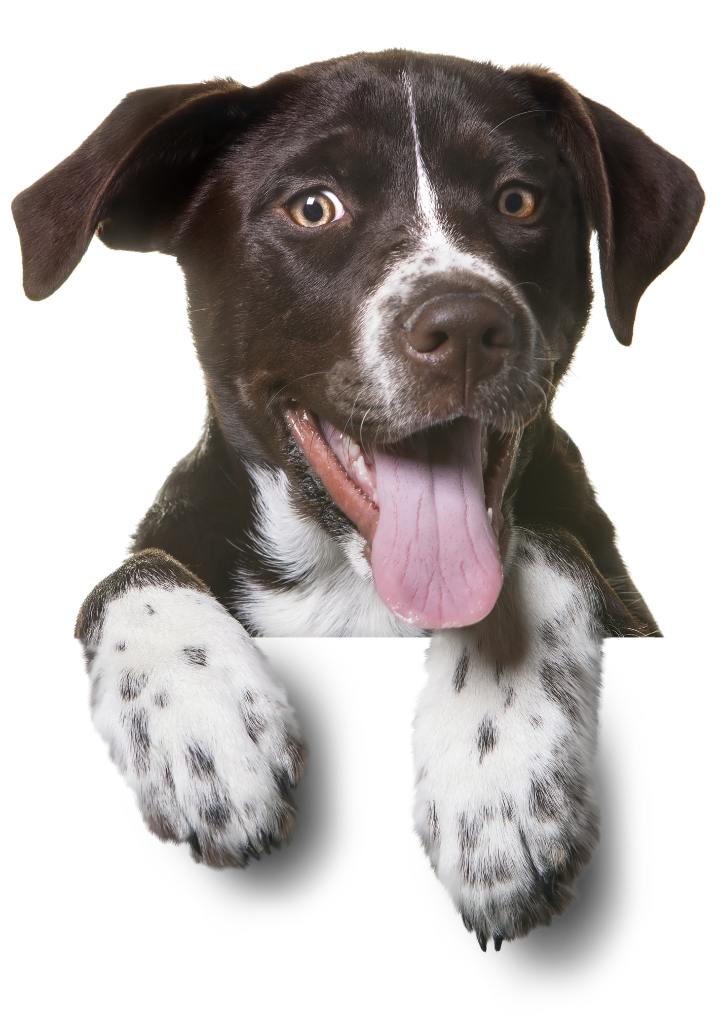
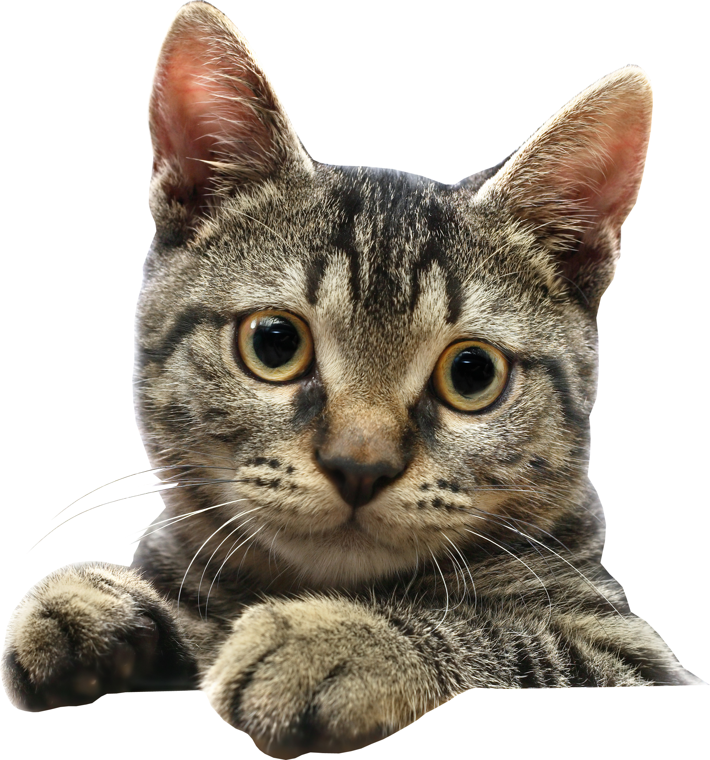
Precision and Recall
This is our little corner of the internet, containing dog photos and cat photos.
We also have a search engine, which can move around the internet. Anything within the search engine is returned to the user.
A little corner of the Internet…
Let’s start with a search for “dog photos”
Precision is a measure of how many returned dog photos are actually dog photos.
Recall is the percentage of dog photos that are correctly returned by the search bar.
Dog Photos
Cat Photos
Our first search returns low precision but high recall. All the dog photos on the internet are returned, but there are some cat photos too!
Our second search returns high precision andlow recall. Not all of the dog photos are returned, but all of the photos returned are dog photos!
What would the following searches be? (the search is still for dog photos?

Slide 18
Precision and Recall
But how does this work for other types of AI, let’s say a cancer diagnosis classification model.
To the left is a set of test data for a cancer detection AI.
Breast Cancer Tumours
You can have different precision and recall scores for each class, i.e. malignant and benign. Consider this like doing a search for “malignant” and “benign” in our previous example.
Key
Malignant
Benign
Model 1 gives the following line. For the ‘malignant’ class it has high precision but low recall. Can you answer for the ‘benign’ class:
Does this show high or low precision?
Does this show high or low recall?
Mean Diameter (mm)
Malignant
Malignant
Model 2 gives the following line. For each class:
Does this show high or low precision?
Does this show high or low recall?
Benign
Benign
Imagine you are a clinician using one of these models. Would you rather have:
High precision and low recall
High recall and low precision
Growth Rate (mm/d)

